Slide 1

Introduction to Automated Deployments with Azure DevOps
Erin Dempster
March 21st, 2026

Slide 2
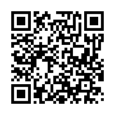
Link to Materials
https://github.com/endlessautomation/SQLSat/tree/main/ATL2026

Slide 3

Erin
Dempster
Pronouns: She/Her
Enterprise Architect
SQL Server DBA
Azure Administrator
Azure DevOps Administrator
Speaker – PASS Summit, SQL Saturdays +
Author – SQLServerCentral.com
Trean Corporation
https://www.linkedin.com/in/erindempster

Slide 4
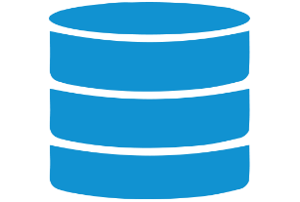



Session Workflow (aka Agenda)
Azure Pipelines
Build
Automated Tests*
Approve
Deploy
Repeat 3&4
Test
Dev
Visual Studio
Reverse Engineer
Develop
Unit Test
Commit Changes
UAT
Prod
Git Client
Azure Repos
Git Repositories

Slide 5

Session Workflow (aka Agenda)
Azure Pipelines
Build
Automated Tests*
Approve
Deploy
Repeat 3&4
Test
Dev
SSMS
Develop
Unit Test
Commit Changes
Visual Studio
Reverse Engineer
Develop
Unit Test
Commit Changes
UAT
Prod
Git Client
Azure Repos
Git Repositories

Slide 6
Say What !?! I use a database!!
Why do I need Visual Studio or VS Code?

Slide 7
Say What !?! I use a database!!
Why do I need Visual Studio or VS Code?

Slide 8
.NET project lifecycle
C# project
Build and ship
build
exe/dll
deploy
app host

Slide 9
SQL project lifecycle
SQL project
Build and ship
build
dacpac
deploy
database

Slide 10






.sqlproj
.dacpac
Database
build
deploy
SQL project contains
SqlPackage deployment
CREATE TABLE Customer
(
FirstName NVARCHAR(100) NOT NULL,
LastName NVARCHAR(100) NOT NULL,
Region NVARCHAR(100) NULL
)
ALTER TABLE Customer
ADD Region NVARCHAR(100)

Slide 11
SQLPackage.exe
Command-line utility coordinating work on .dacpac or .bacpac file
Install → dotnet tool install -g microsoft.sqlpackage
Seven Operations
  Extract – create a dacpac from a database
  Publish – use a dacpac to deploy incremental schema changes
  Export – create a BACPAC with schema AND data
  Import – use the BACPAC to import schema AND data
  Deploy Report – get feedback on objects that would be updated
  Drift Report – get feedback on the state of the database
  Script – generate the incremental deployment script to review

Slide 12
SDK-style SQL projects

Slide 13
SQL projects got old
Original .sqlproj
Limitations of original SQL projects restrict it to use with
slow development cycles and all-Windows CI/CD infrastructure.
Default project properties explicitly listed
Every file (SQL object) listed explicitly
Requires .NET Framework for build
Requires Data.Tools.Msbuild or Visual Studio installed to build

Slide 14
SQL projects got old
Original .sqlproj
SDK-style SQL projects
Default project properties explicitly listed
Every file (SQL object) listed explicitly
Requires .NET Framework for build
Requires Data.Tools.Msbuild or Visual Studio installed to build
Project defaults not required in project file
All *.sql files in contained folders included by default
Supports .NET 8+ or .NET Framework to build
No additional build requirements
🪄 more magic

Slide 15

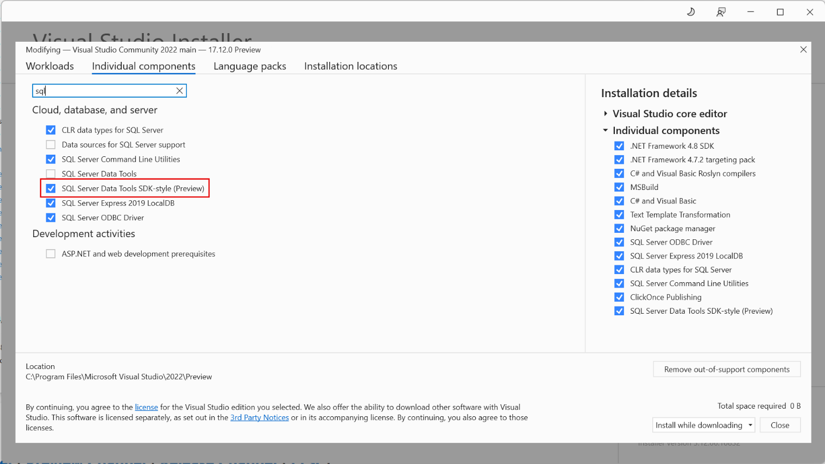
SDK-style SSDT (preview)
Available in 17.12+
Conflicts with original SSDT
Install in a standalone Visual Studio instance

Slide 16

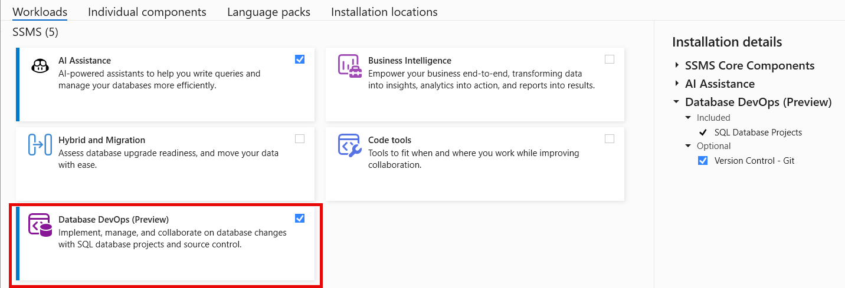
SDK-style Database Project (preview)
Available in 22.4.1
Database DevOps workload

Slide 17
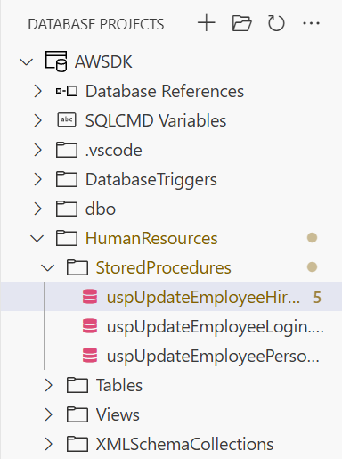
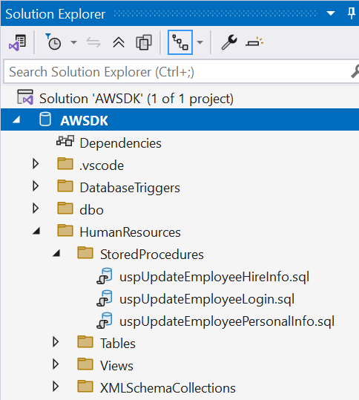
Current SDK Project Limitations
Reverse Engineer Database Schema
  Needs VS Code;
  VS 2022 and 2026 don’t do it
  SSMS v22 will do it by May/June 2026
Schema Comparison w/project
  Needs VS Code; VS 2022 works with old project type

Slide 18
Demo
Database Project

Slide 19
Introduction to
Azure Pipelines

Slide 20
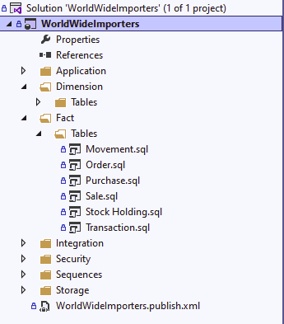
Azure Pipelines
Manages code builds and deployments
Triggered by source code check-ins or
merging code into another branch
Notes:
Straight out of Microsoft Learn - “Azure Pipelines automatically build…code projects”
Yes, data projects count! A database’s schema is your code, from tables and views to stored procedures and functions. While you have database backups, you should store the code in source control.
When you do store code in source control, pipelines can be triggered on code commits, either a check-in or on approval of a pull request.
Using YAML, the workflow that suits your specific needs can be created. If you have 3 environments, great!. If you require a manager’s approval before deploying to production, no problem.

Slide 21
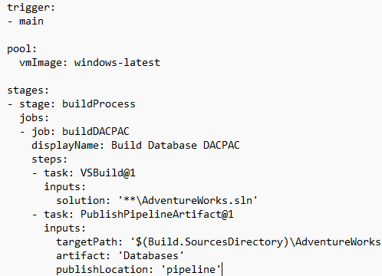
Azure Pipelines
Many pre-defined tasks
  Visual Studio Build
  Publish & Download Artifacts
Scripting tasks
  PowerShell
  BASH
Define YOUR workflow in YAML
Notes:
Azure Pipelines offer a bunch of pre-defined tasks from building a solution to running automated tests and deploying to different types of systems/services.
If there isn’t a predefined task, write your own process with a scripting language of your choice. This screenshot shows 2 PowerShell tasks, but I could have used Bash scripts to do the work.
Microsoft provides 2 methods to define a pipeline, using the classic version, allowing drag-and-drop capabilities, or writing the pipeline entirely in YAML. For your sake, the 1st demo will use the GUI, so you don’t have to watch me fumble AS MUCH with syntax and configuration. The 2nd demo will use YAML that I’ve built ahead of time.

Slide 22
Ways to Run Pipelines
Azure-hosted Pipeline Agents
  Great for building code/build validation
Self-hosted Pipeline Agents
  Preferred for deployments

Slide 23
Pipeline Options
 | Build Pipeline | Release Pipeline
Classic | No* | Yes
YAML | Yes | Yes
Optimal Design - Multi-stage YAML Build and Release Pipeline

Slide 24
Azure Pipelines
YAML Schema - https://tinyurl.com/4z7x3mkw
Task Index - https://tinyurl.com/56vf436z
Pipeline Variables - https://tinyurl.com/ye2ypvum

Slide 25
What is YAML?
“YAML Ain’t Markup Language”
Configuration Layout
Used by both Azure DevOps and GitHub Actions

Slide 26
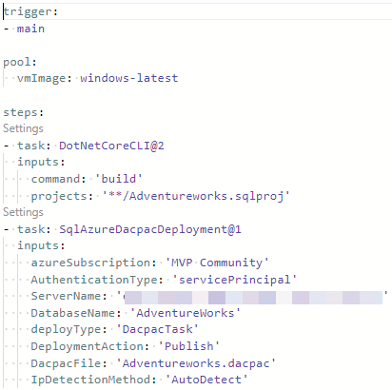

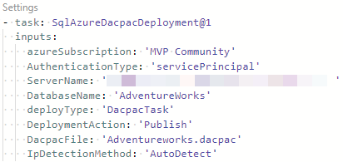
Basic Pipeline
Implied Single Stage with one job
1st task – builds the project
2nd task – deploys the DACPAC using SQLPackage.exe
Both tasks run in the same agent instance
When to use this scenario?
Proof of concept
Testing connections
Build Validation/Automated Testing

Slide 27
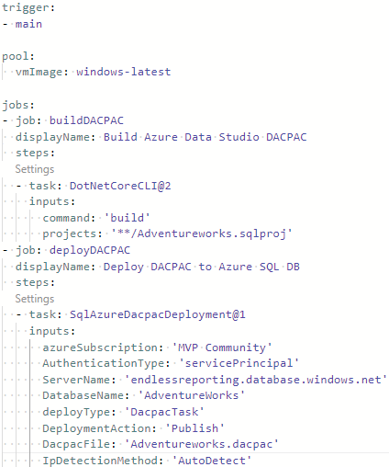
Explicit Job Definitions
Two Jobs each with one task
1st job – builds the project
2nd job – deploys the DACPAC using SQLPackage.exe
Each job runs in a separate agent instance

Slide 28
Explicit Job Definitions
There is a problem with this pipeline!
DACPAC is not shared between jobs

Slide 29
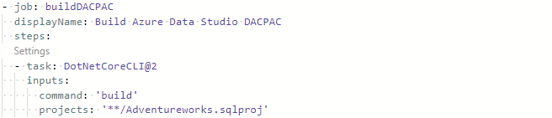
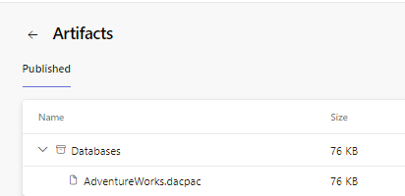
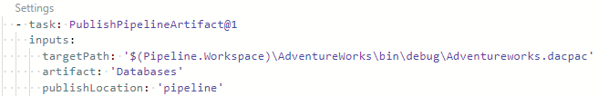
Publish DACPAC as a Pipeline Artifact

Slide 30
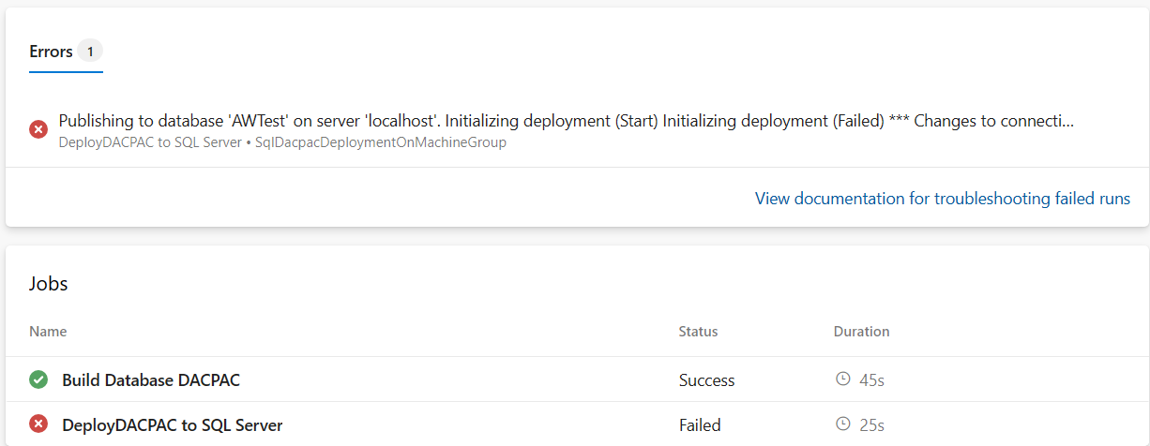
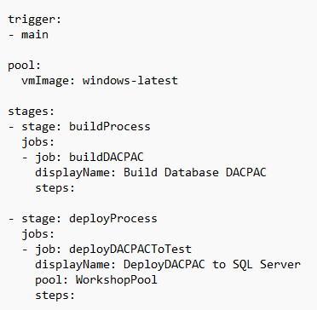
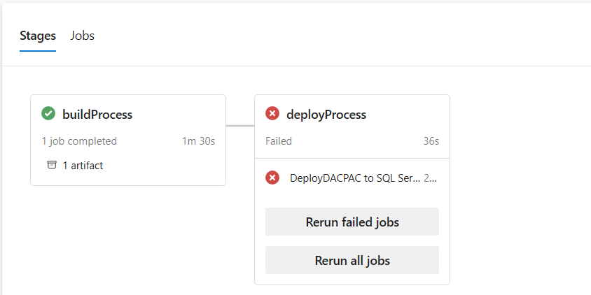
Explicit Stage Declaration

Slide 31
Agent Setup
Define a Pipeline Agent Pool
Generate a Personal Access Token (PAT)
Install Agent
Configure Agent

Slide 32
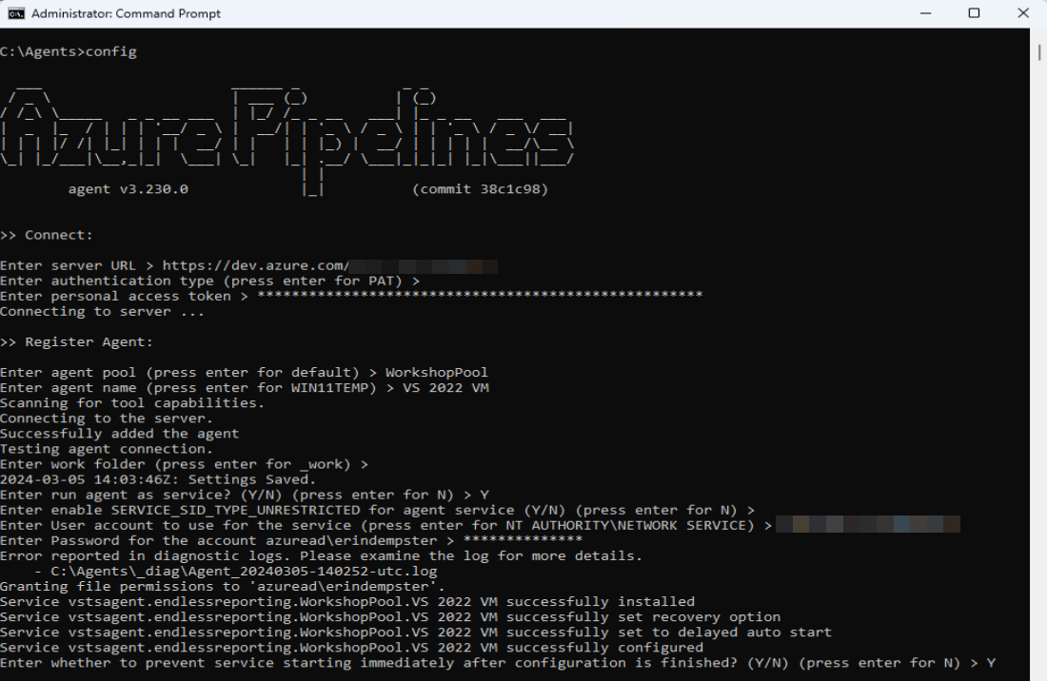
Self-Hosted Pipeline Agent

Slide 33
Common Pipeline Tasks

Slide 34
Common Tasks for Databases
Building DACPACs
VSBuild@1 – Build Visual Studio project with MSBuild
DotNetCoreCLI@2 – Build Azure Data Studio project

Slide 35
Common Tasks for Databases
Artifact Management
PublishBuildArtifacts@1 – Publish Files to Pipeline
DownloadPipelineArtifact@2 – Download Files from Pipeline

Slide 36
Common Tasks for Databases
Deployment Tasks
SqlAzureDacpacDeployment@1 – Deploy to Azure SQL DB
AzureCLI@2 – Execute PowerShell scripts in Azure context
PowerShell@2 – Execute PowerShell scripts

Slide 37

Deploy DACPAC with PowerShell
Requires
  SQLPackage.exe

Slide 38
Demo
Deploy Database Changes

Slide 39















Thank You To Our Sponsors
For Making SQL Saturday Possible!
SQL Saturday Atlanta 2026 • AI & BI
2
Notes:
[Sources]
- Conference title, event date, and location are based on the official SQL Saturday Atlanta 2026 event page: https://sqlsaturday.com/2026-03-21-sqlsaturday1127/
- Color palette is derived from the user-provided logo image in this conversation.

Slide 40
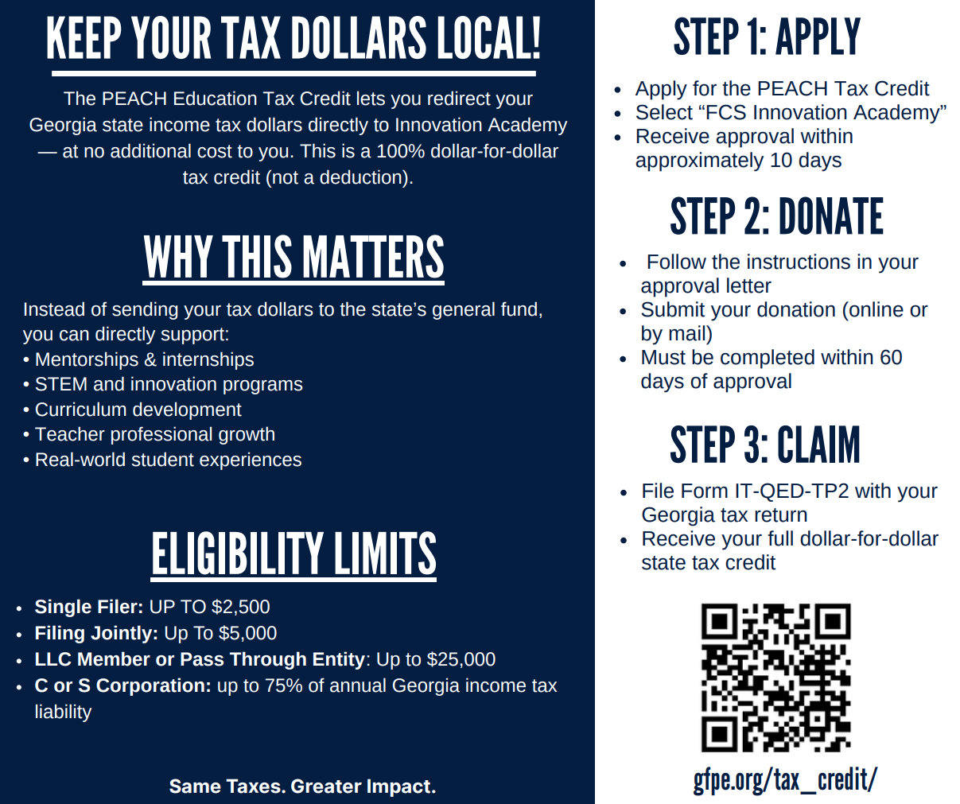

A Very Special Thank You To Our Community Partner
Innovation Academy!
Please Support Via Tax Credit Eligible Donation That Goes DIRECTLY To Innovation Academy
SQL Saturday Atlanta 2026 • AI & BI
2
Notes:
[Sources]
- Conference title, event date, and location are based on the official SQL Saturday Atlanta 2026 event page: https://sqlsaturday.com/2026-03-21-sqlsaturday1127/
- Color palette is derived from the user-provided logo image in this conversation.

Slide 41
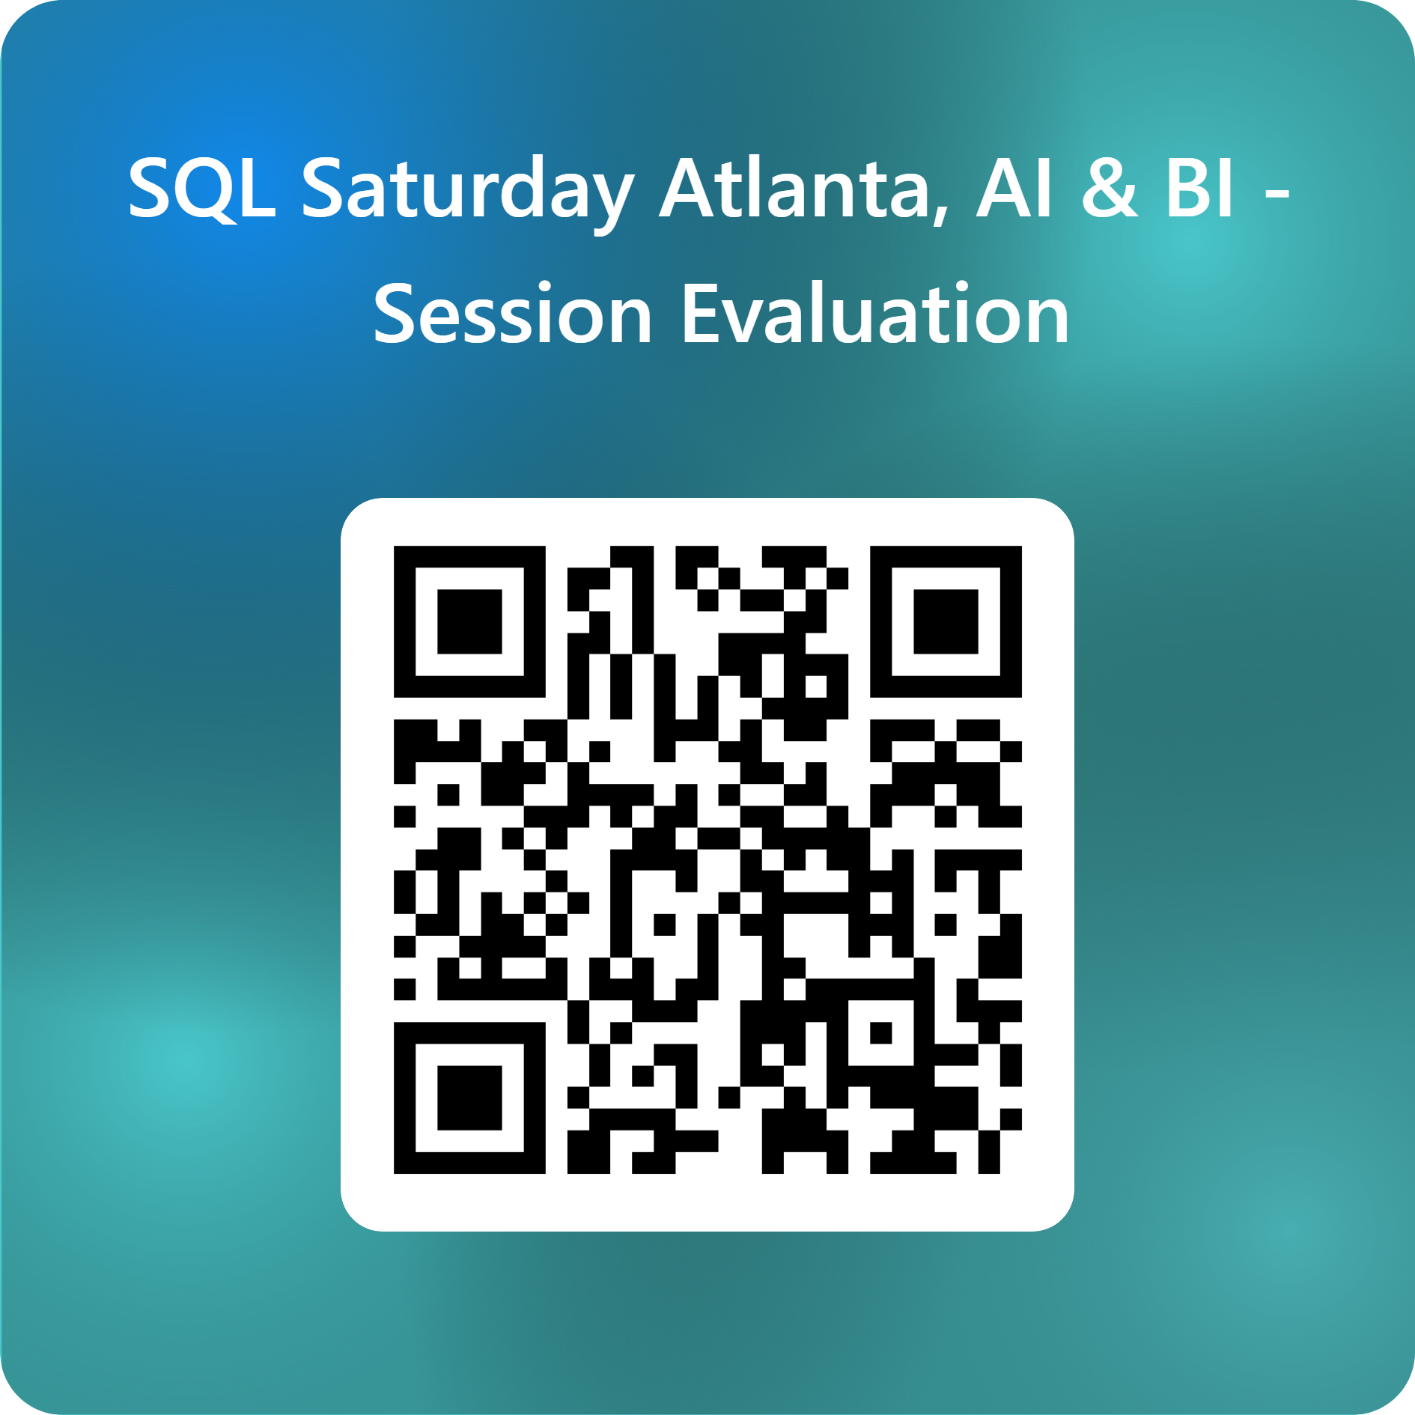
Session Evaluations
SQL Saturday Atlanta 2026 • AI & BI
2
Notes:
[Sources]
- Conference title, event date, and location are based on the official SQL Saturday Atlanta 2026 event page: https://sqlsaturday.com/2026-03-21-sqlsaturday1127/
- Color palette is derived from the user-provided logo image in this conversation.

Slide 42
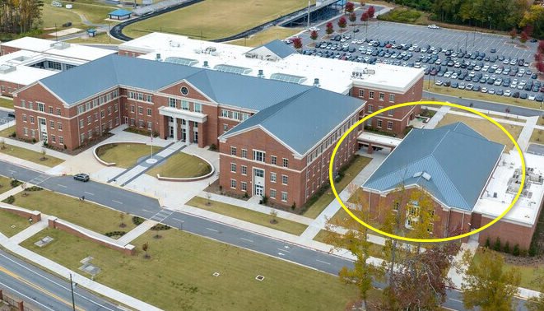
SQL Saturday Atlanta Closing Ceremony
5PM In The Auditorium
Must Be Present To Win Raffle Prizes
SQL Saturday Atlanta 2026 • AI & BI
2
Notes:
[Sources]
- Conference title, event date, and location are based on the official SQL Saturday Atlanta 2026 event page: https://sqlsaturday.com/2026-03-21-sqlsaturday1127/
- Color palette is derived from the user-provided logo image in this conversation.

